Slide 1


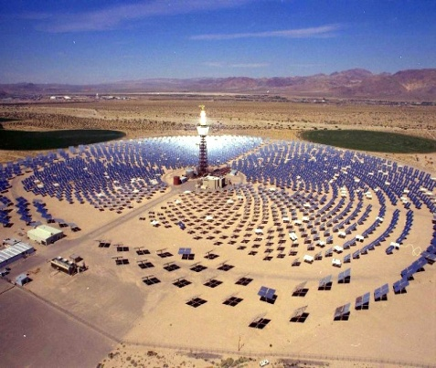
UNDP csp tt nam project OBJECTIVES, DELIVERABLES, COMPONENTS & FINANCING PLAN
Yogesh Vyas
Energy, Environment & Climate Change Consultant
Energy, Transport and Water; USA
G. L. Jonas Capôco
Managing Director
Asca Investment (Pty) Ltd ; Namibia
Windhoek, Namibia
1 December 2010

Slide 2
CSP TT NAM PROJECT OBJECTIVES
Overall goal is to develop the GEF Project Document for the CSP Technology Transfer for Electricity Generation in Namibia.
Objective is to lead the formulation of the CSP TT NAM full size project in full consultation and participation of the MME, UNDP and REEEI, as well as other key stakeholders (power utility, electricity distribution entities, academia, private-sector and civil society) resulting in final product of the UNDP/GEF ProDoc package.

Slide 3
CSP TT NAM Project Deliverables
The consultant will prepare the following document:
A UNDP/GEF Project Document, with all annexes including but not limited to an Incremental Cost Analysis, a Logical Framework and draft Terms of References
A Request for CEO Endorsement including response to GEFSEC/ STAP and Council Comments and a PPG Completion report
An annotated Total Budget and Work Plan
Co-finance Commitment letters equal to the indicated figures in the PIF application

Slide 4
CSP TT NAM PPG Reports
The key deliverables of this work will be:
PPG Activity 1 : Capacity building needs assessment (government, private sector) and recommendations for project capacity strengthening and awareness creation activities to build, operate and maintain CSP technologies;
PPG Activity 2 : Review of status and policy on renewable energy (market, fiscal and regulatory framework, grid technical standards for quality, reliability and safety), including a basic study to find opportunities and needs on CSP technologies and measures;
PPG Activity 3 : Identification and collaboration with CSP industry and commercial participants (CSP potential, risks, funding arrangements);
PPG Activity 4 : Preparation of an implementation plan for strengthening of the REEEI and the MME on CSP technology;
PPG Activity 5 : Stakeholder consultation and elaboration of documentation of full-sized GEF project proposal (including Project Management);

Slide 5
CSP TT NAM Project Deliverable Timeline

Slide 6
CSP TT NAM PROJECT COMPONENTS, OUTPUTS & OUTCOMES
Component 1: Establishment of CSP Technology partnerships
CSP technology is still confined to a few players in the world in Germany, Israel, Italy, Spain, United States of America and other developed countries with active applied research. Under this component, the following outcomes are expected:
(1) Established technology partnerships between foreign technology providers and Namibian partners including private sector, academia and government; and
(2) Enhanced knowledge of applicable CSP applications in Namibia.
To realize this, the project will carry out a scoping and due diligence analysis of global players (using some of the networks created through the TREE project CSP Seminar), finalize and create a few additional partnerships through memoranda of understanding to facilitate technology transfer. Other activities will focus on building interest amongst local industries through their associations such as the Namibia Chamber of Commerce and Industry (NCCI), so that they are embedded in the project from onset.

Slide 7
CSP TT NAM PROJECT COMPONENTS, OUTPUTS & OUTCOMES
Component 2: Market Policy Framework for CSP technology
This component will consist of activities that will contribute to the development of the following outcomes:
(1) Approved policies supportive of CSP technology applications; and
(2) A thriving CSP market in Namibia. ????
The activities will involve insuring that a policy framework is put in place to support and guide the deployment of CSP technology. Technical interconnection and guidelines for power purchase agreements will be developed.

Slide 8
CSP TT NAM PROJECT COMPONENTS, OUTPUTS & OUTCOMES
Component 3: Business Model and Financing Framework for CSP projects
Activities in this component will help bring about the following outcomes:
(1) Financing institutions/banks providing loans to CSP projects; and,
(2) Increased number of CSP installations in the country.
The activities that will be carried out to deliver the outputs that will contribute to the realization of these outcomes include a detailed analysis of the technologies identified in Component 1 and the development of a concrete business case and financial model that will lay the foundation for the pre-commercial plant to be established. The business model will explore and define the appropriate technical, financial and economic parameters for the CSP plant.

Slide 9
CSP TT NAM PROJECT COMPONENTS, OUTPUTS & OUTCOMES
Component 4: CSP Pre-commercial demo plant
The expected outcomes under this project component are basically related to the demonstration of an operating CSP facility. These include:
(1) Improved confidence of the government and citizenry on the techno-economic viability of CSP; and
(2) Several replications of the CSP plant.

Slide 10
CSP TT NAM PROJECT WORKPLAN
The following activities, with estimate time periods, will be performed in this component of the project life cycle of the 5 MW CSP power plant;
Project Development (12-24 months)
Authorisation, bankable solar resource developed,
Basic design (feasibility study - parabolic trough, central tower and linear Fresnel are the 3 solar collector technologies to be examined; storage and non-storage options will also be considered), tendering (e.g. solar collector technologies identified from the feasibility study), contracts, special conditions agreed and signed.
Note:The likely technology would be parabolic trough as it is well-proven in the global market (as well as the preferred choice of SUNTEC Namibia (Pty) Ltd), and thus would assist in securing partnerships with established service providers/contractors (trough configuration is the most widely used across the world, with the most currently operating and under construction plants, and having been commercialized since 1985)

Slide 11
CSP TT NAM PROJECT WORKPLAN
Project Construction (24 months)
Ground breaking, mobilisation, re-evaluation, detailed engineering, earthworks performed,
Delivery of equipment, civil works, assembling of main equipment, pre-commissioning,
Commissioning, functional tests start up.
Warrant Period (12 months)
Trial runs and tuning of the plant.

Slide 12
CSP TT NAM PROJECT WORKPLAN
Plant running (24 months)
O&M information management is designed to integrate information communication technology for operation and maintenance.
Plant operating strategy will be developed to deal with staffing, mirror breakages, storage options, reflectance and heat loss; as well as monitoring and recording of operating events such as power generation, water consumption; climate data etc. This will help analyze and calculate O&M and subsequent generation costs for larger commercial plants. It is expected that there will be a reduction in risk premium whilst lessons will be learnt on risk and environmental impact mitigation.
The overall project outcome is a scenario of an emergence of local entrepreneurs and technologists capable of integrating the various technologies and experiences for large scale replication for power generation and process

Slide 13
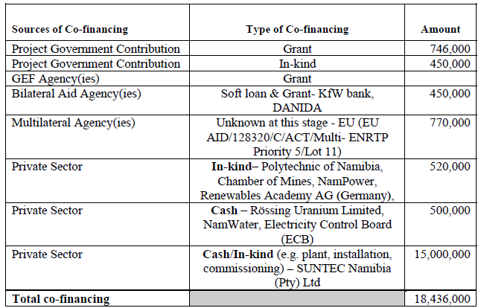
Indicative Co-financing by Source and by Name ($)

Slide 14
Indicative Financing Plan Summary ($)

